Slide 1


“Enhancing Audio Security Through LSB-Based Steganography”
G.V. Sai Trinadh Raju(RO200532)
G. Durga Sivani(RO200364)
S. Swetha(RO200071)
A. Sahithi Supriya(RO200888)
K. Bhanu Samyuktha(RO200290)
Guided by
G. Vijaya Kumari
Assistant Professor, ECE
RGUKT Ongole

Slide 2
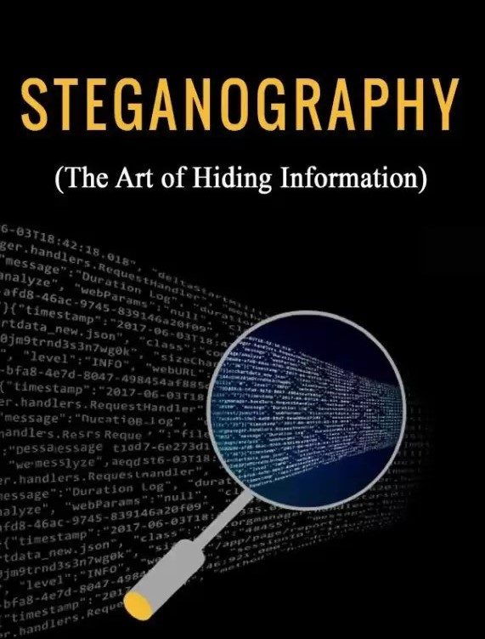

Slide 3
Abstract
In the age of Digital Communication, Data Security and privacy have become crucial concerns. This project explores audio Steganography as a means of securing sensitive information, focusing specifically on the Least Significant Bit (LSB) method. Audio steganography involves embedding data within audio files in a way that is imperceptible to the human ear.
The LSB method modifies the least significant bits of audio samples to encode binary data, such as text or images, without significantly altering the audio quality.
This approach provides a balance between security and simplicity, making it a suitable choice for hiding confidential data within commonly used audio formats.

Slide 4
Introduction
The growth of high-speed computer networks and the internet has indeed revolutionized communication but has also brought concerns about data security and privacy. To address these issues, there are primarily two techniques commonly used.
1. Cryptography
2. Steganography
Before considering Steganography, we will just have a glance of its
premises technique which is called Cryptography.

Slide 5

CRYPTOGRAPHY
Cryptography is the process of
Hiding or coding information.

Slide 6
Cryptography is an art of Encryption and Decryption of confidential information that can be implemented to prevent any leakage and threat.
TYPES
Classified into Two types :
Symmetric key Cryptography
Asymmetric key Cryptography

Slide 7
Readable format
Readable format
Non readable format
PLAIN TEXT
CIPHERTEXT
PLAIN TEXT
ENCRYPTION
DECRYPTION
Flow chart of Cryptography

Slide 8
STEGANOGRAPHY
What is Steganography?
Steganography is the art and science of writing hidden messages in such a way that no one, apart from the sender and intended recipient, suspects the existence of the message, a form of security through obscurity.
The word steganography is of Greek origin and means “concealed writing” from the Greek words steganos meaning “covered or protected”, and graphein meaning “writing”.
“Steganography means hiding one piece of data Within another”.

Slide 9

Types of Steganography
Text steganography : Hiding the data in the text i.e , By manipulating the lines and words, in HTML file
Image Steganography: Secret Data is hidden in the images by the methods LSB insertion, Masking, Filtering.
Audio Steganography: Conceals information within audio files, such as playing secret messages backward on a track.
Video Steganography: Encodes entire videos by hiding a separate image in each video frame
Network Steganography: Hides information inside network traffic, such as within the TCP/IP headers or payloads of network packets.

Slide 10
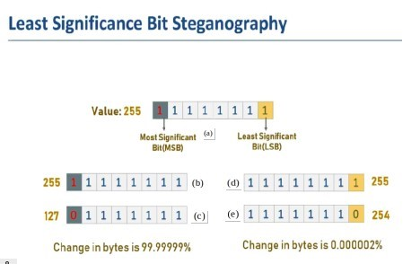
Least significant bit algorithm
In a byte the left most bit is called as Most significant bit (MSB) and the rightmost bit is called as Least significant bit (LSB).
The audio file is converted into 16-bit PCM. And the Text file
is converted into 8-bit binary. The 8-bit binary is replaced in
the 16-bit LSB values. Now the binary 16-bit PCM is
normalized into audio signal.
There is no difference in input Audio file to the Encrypted
audio file.

Slide 11
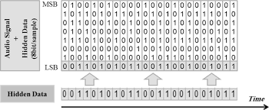
LEAST SIGNIFICANT BIT
At the decryption end Encrypted file is converted into 16-bit PCM.
Now the LSB bits are retrieved and arranged in 8-bit manner.
8-bit Binary is converted into readable text.

Slide 12

Current methodology used in audio steganography
Data Protection in Audio Files:
It allows confidential information to be securely embedded in everyday audio files without the information being easily detected.
Invisible Data Hiding:
No one can tell that hidden information is present just by listening to the sound. This makes it much harder for attackers to intercept or detect .
Combating Cyber Threats:
Using steganography, especially in audio files, offers a novel way to secure communications, ensuring that only the intended recipient can retrieve the hidden information. This strengthens overall cybersecurity.

Slide 13
Future advancements of audio steganography
AI Integration: Using machine learning and AI for adaptive, robust embedding techniques.
Real-time Applications: Developing real-time secure communication systems.
5G and IoT: Ensuring secure data transmission in IoT and 5G networks.
Hybrid Techniques: Combining multiple steganography methods (e.g., DWT and LSB) for better security.
Blockchain: Leveraging blockchain for traceability and enhanced data authenticity in steganographic applications.
AI Integration
5g and IOT tech
Future advancements
Block chain technology
Hybrid techniques

Slide 14
Encryption
Input audio
Encryption key
Encrypted Audio Signal
Secret Message

Slide 15
Decryption
Encrypted Audio Signal
Decryption Key
Text Message

Slide 16

THANK YOU

